Slide 1
NESC
Newly Encapsulated Screens
SUB_CODE: IED-001
Naveen Kumar Jha 2022518370
Aman Sinha 2022534811
Saumya Suman 2022438521

Slide 2
Submitted to
Dr. Nishant Gupta

Slide 3
Abstract
The project is Titled as NESC, standing for Newly Encapsulated Screens. It aims to deliver the user wearing an helmet to display the output from a computer system with a camera to avoid collisions. The information displayed will be taken from the small computer running python scripts for object detection, trained from Tensorflow and using CV2, the execution of code will result in a real time object detection. One can train a model for incoming vehicles, lethal objects, unrecognized objects which can lead to a collision of user. The screen is to placed inside the helmet to provide an augmented reality environment that displays the incoming objects as lethal and warns users about its speed and various factors which can result in a collision. One can work with a raspberry pi model or a mobile device (with camera) or a raspi-camera along with a VNC server either on a mobile device or on the raspberry pi to provide computation for the output. The output will be shown as objects circled in red for avoidance, yellow for dangerous and various colors representing users needs. The computation is done through python coding on the raspberry pi or simply using the VNC server on the android device to send information if internet connection is possible, else object detection is to be performed using the raspberry pi and raspi-camera to provide instantaneous responses. Future improvement can include
Eye tracking
Smoother connection
Long distance connection
Better performance
Reliable models
Distraction awareness responses
Various other user friendly features

Slide 4
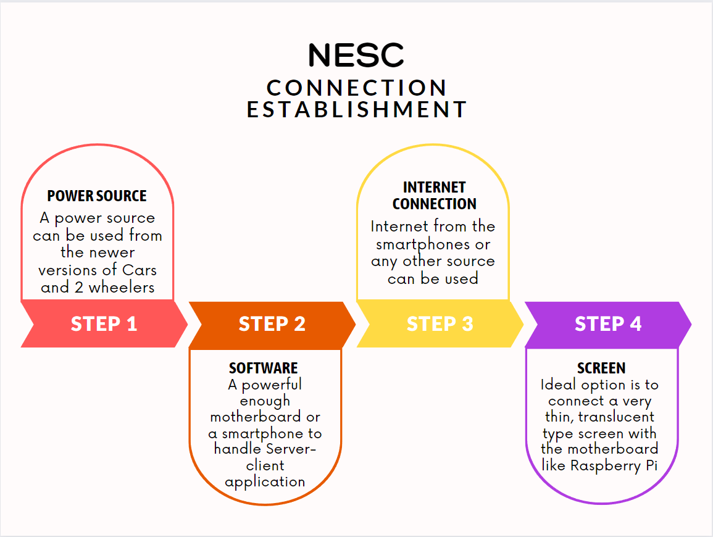
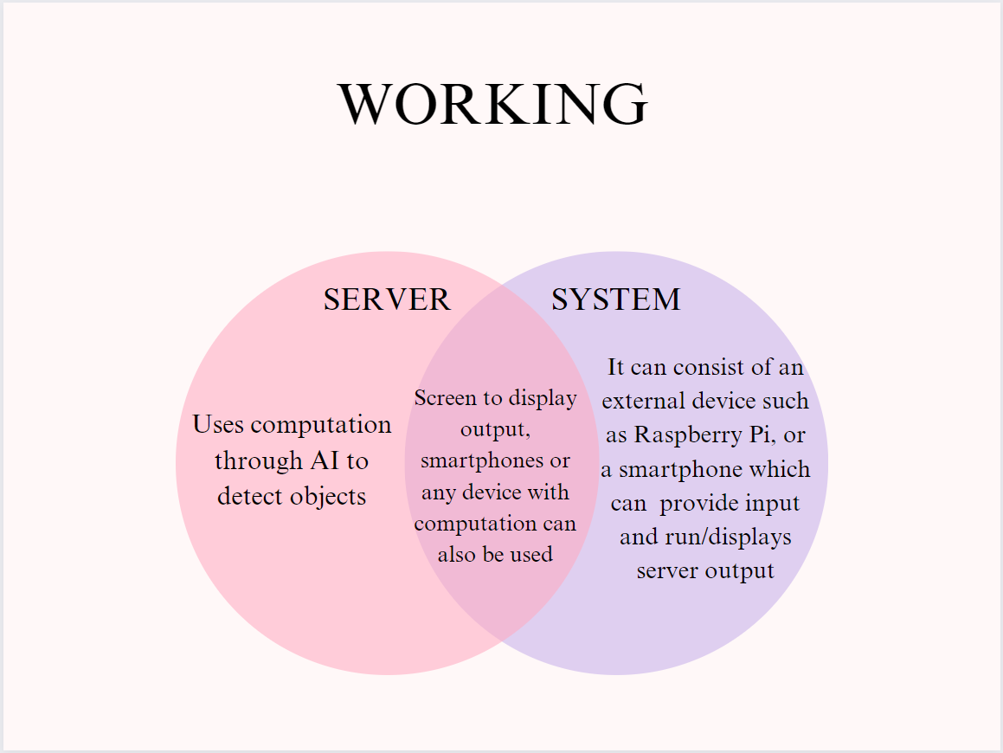

Slide 6
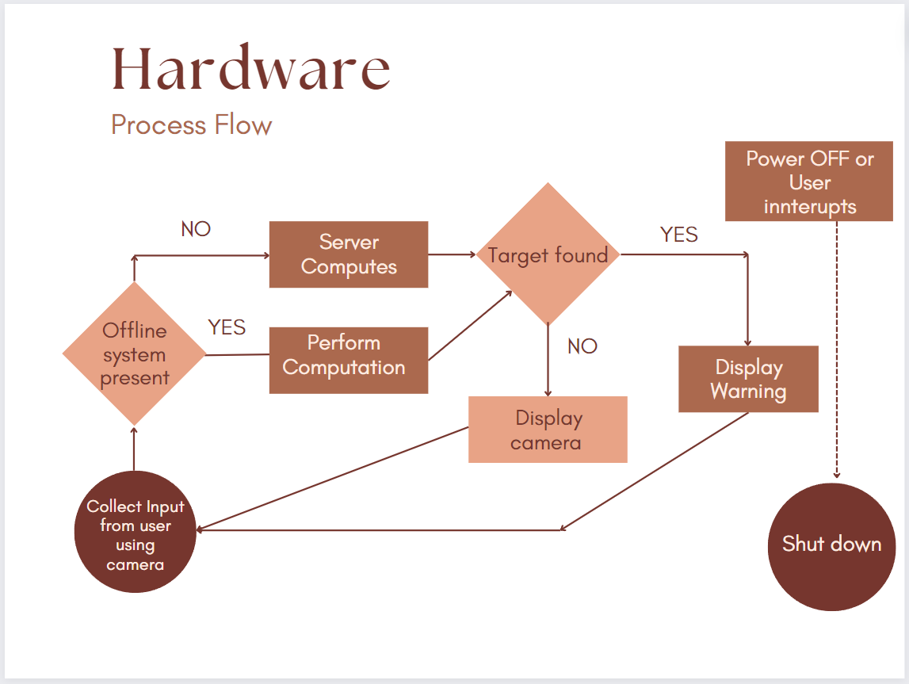
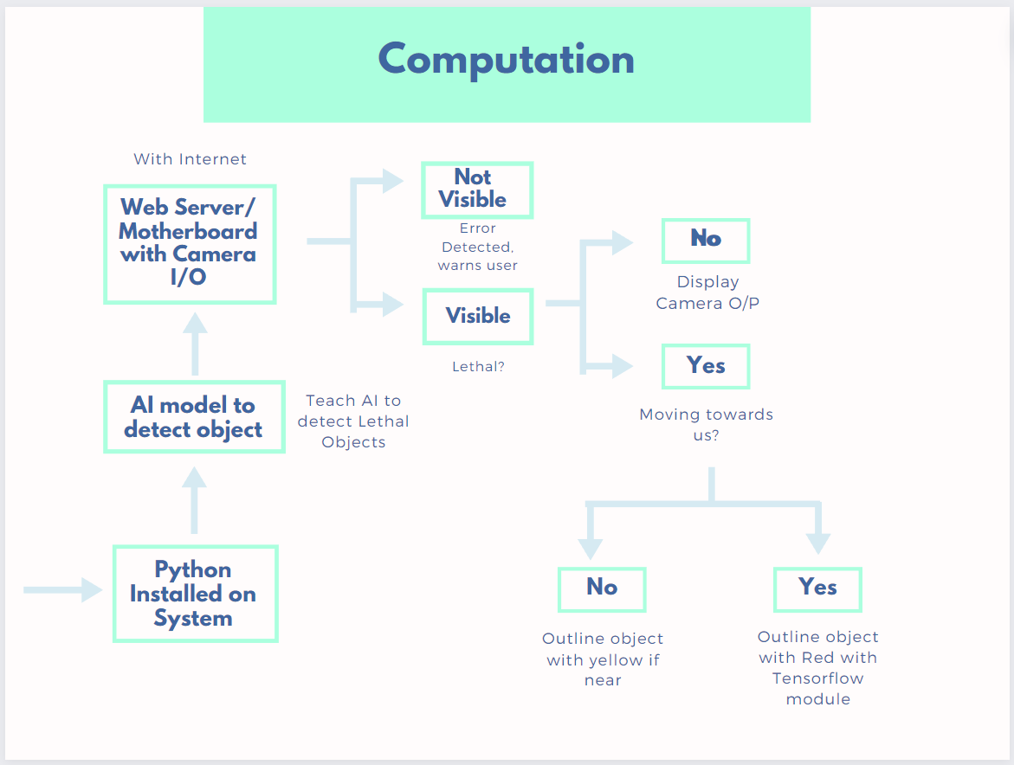

Slide 8
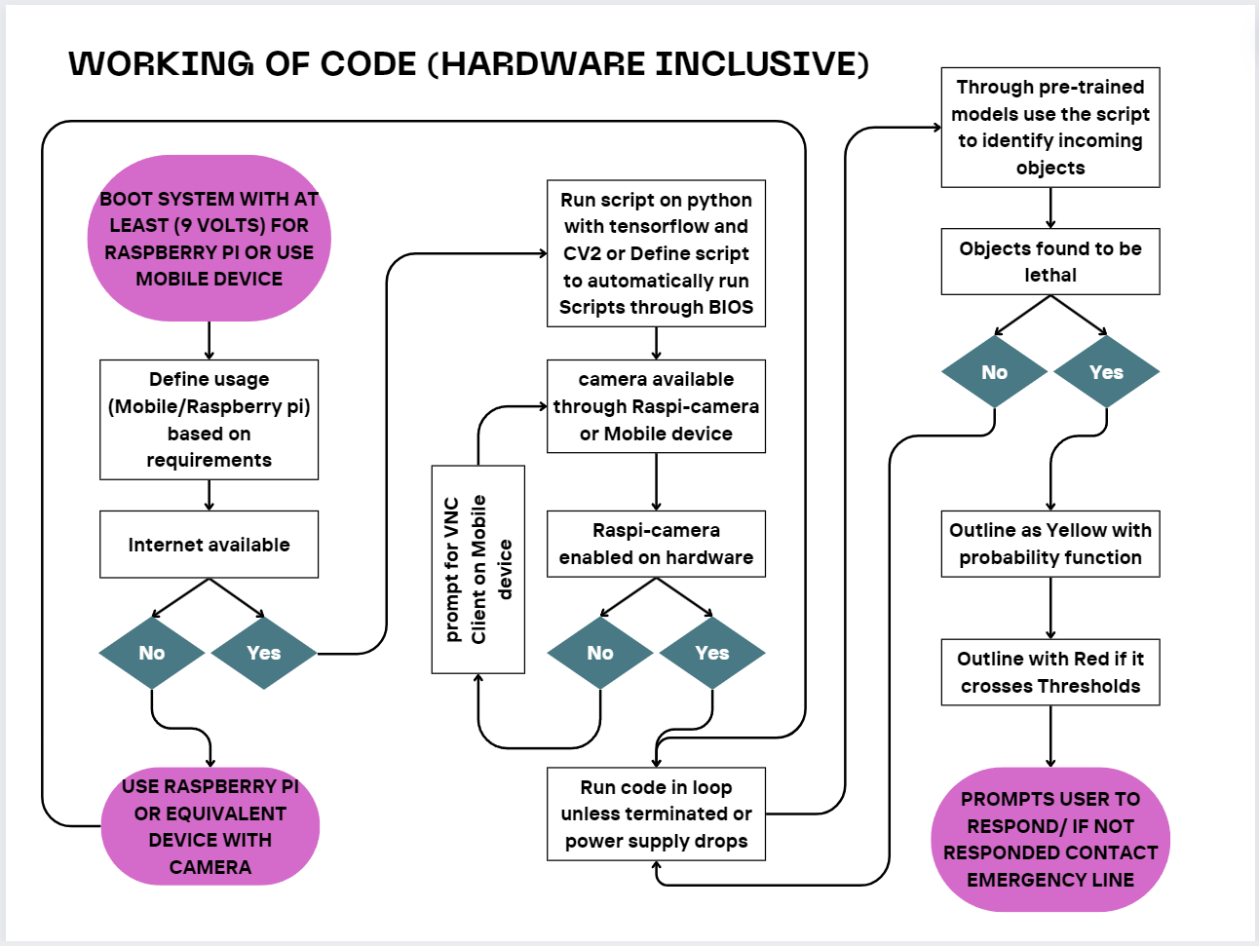

Slide 9
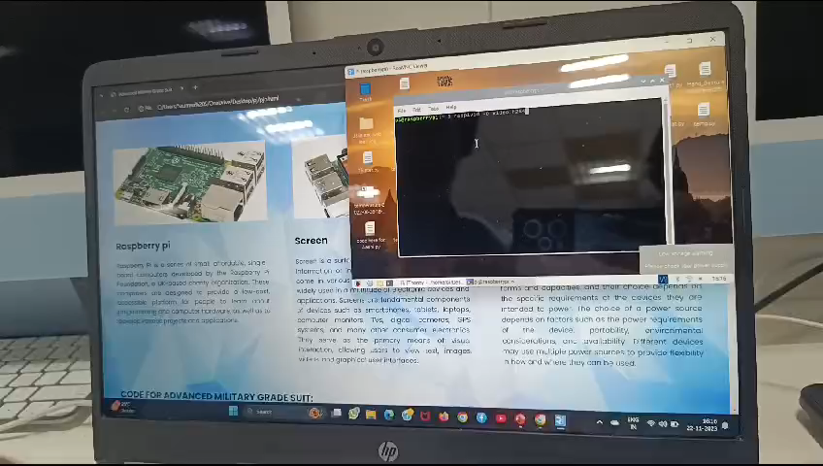

Slide 10
Thank You

